Slide 1
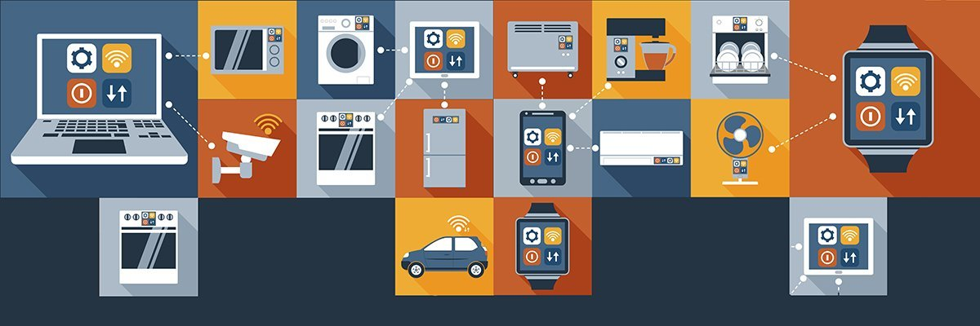
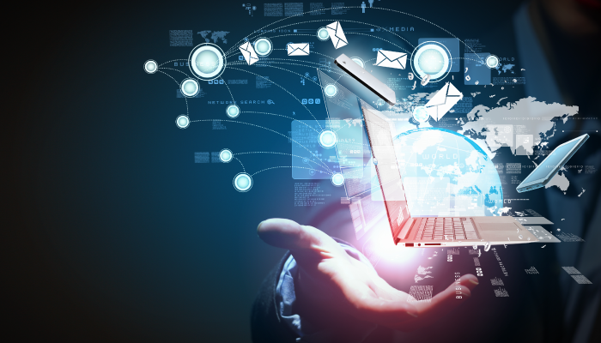
Introduction to Information Technology
LÊ TRỌNG NHÂN
trongnhanle@hcmut.edu.vn
trongnhanle85@gmail.com

Slide 2
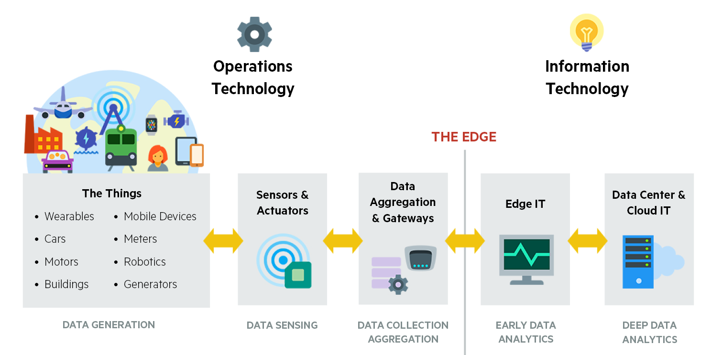
OT and IT …
Notes:
Edge computing is a distributed computing paradigm that makes necessary computation and data storage closer to the devices where it is collected. Compared to relying on a central location such as a server, Edge Computing enables real-time data not to suffer from bandwidth and latency issues that affect device performance.
To put it more clearly, instead of running processes in the cloud, Edge Computing runs operations like a computer, IoT system, or Edge Server at local locations. Long-distance communication within a client and server is now reduced by taking computation to a network edge. Edge computing capacity for computation and processing is needed to run Edge AI applications and algorithms directly on field devices, allowing ML and DL. The amount of data collected by IoT devices in the field is growing exponentially: ML and DL allow Edge AI applications to handle those data in real-time better. It creates Edge nodes where data can be stored, analyzed, sorted, and then forwarded to the cloud for further analysis, processing, and integration with IT apps.

Slide 4
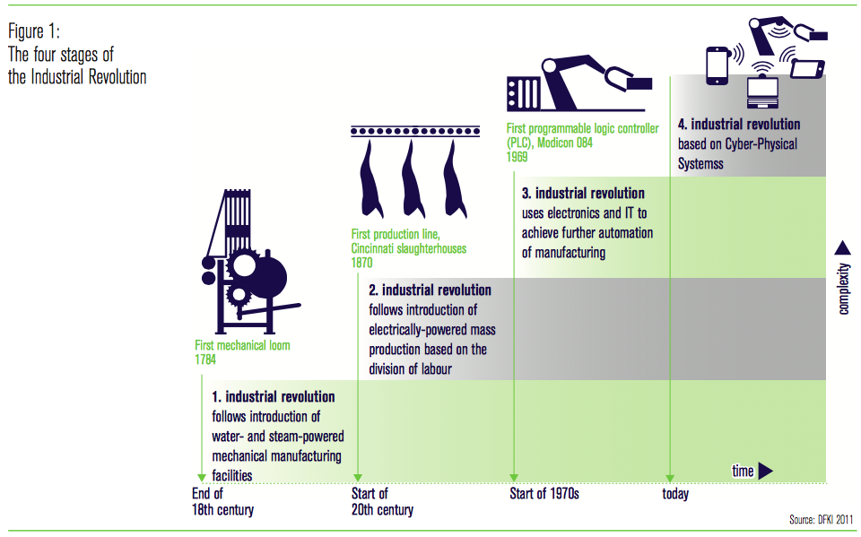
Industry 4.0 (I4)
Notes:
‹#›

Slide 5
Course Outcomes
An overview of current technology (Industrial 4.0):
Internet and Internet of Things
Data collection and Big Data
Machine learning and Deep learning
Cyber security and Blockchain
Operating System: Windows, Linux and Android
Programing on Linux (C and Python)
Programing on Android (Java and Android Studio)
Project on Linux or/and Android:
IoT Gateway – Adafruit IO Server (Python)
Android app – Adafruit IO Server (Java)
AI camera based Google Teachable Machine (Python)

Slide 6

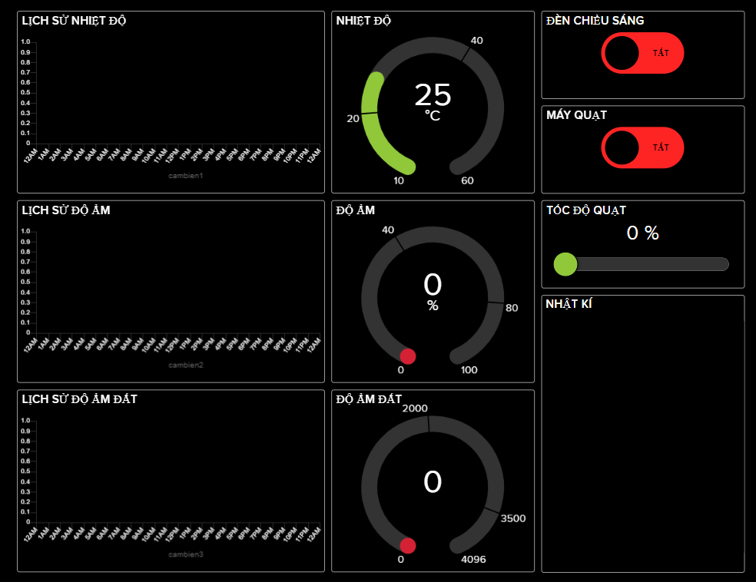
Project Example 1
IoT Gateway
Implemt on PC
Linux based OS
WSL software
IoT Server
Adafruit IO
Data is published to server
Dashboard is required

Slide 7
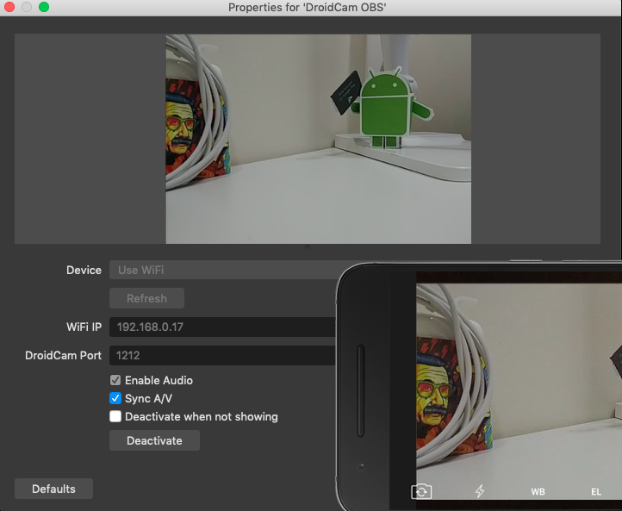
Project Example 2
Smartphone App:
Android
AI Processor
Mobility AI Camera:
Robotics for Smart Warehouse
Flycam for Smart Agriculture

Slide 8
Installed Software
WSL on Windows (Windows Subsystem Service)
Ubuntu 18 or 20 LTS (Long Term Support)
Visual Studio Code and Plug-Ins
Android Studio (Lasted version):
https://developer.android.com/studio

Slide 9

Zalo Group
https://zalo.me/g/ljhnqw040

Slide 10
Content
Introduction
Network and Internet and Internet of Things
I4 Application Architecture
Things Layer and Connect Layer
Potential I4 Applications
Environment Monitoring
Smart Street Light
Autonomous Robots
Edge Computing and Edge AI
Embedded platforms for Edge computing
PyCoral from Google
Demo: Teachable Machine with Google

Slide 11
Content
Introduction to WSL:
WSL installation on Windows
First C program on WSL
Python installation on WSL
“Hello world” program using Python

Slide 12
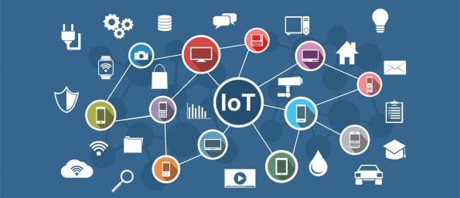
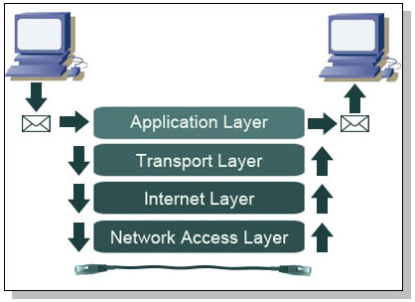
Network, Internet and Internet of Things

Slide 13
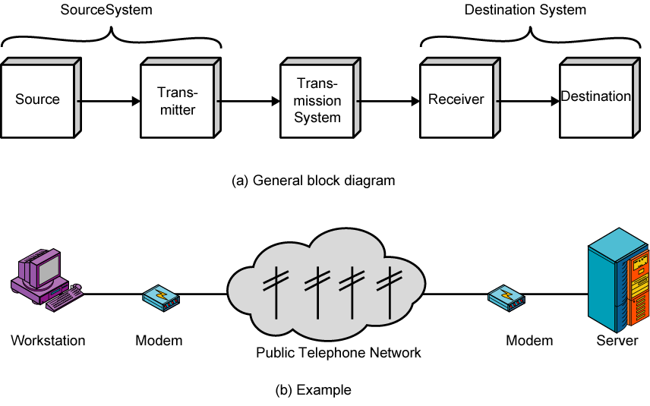
Communication Model

Slide 15
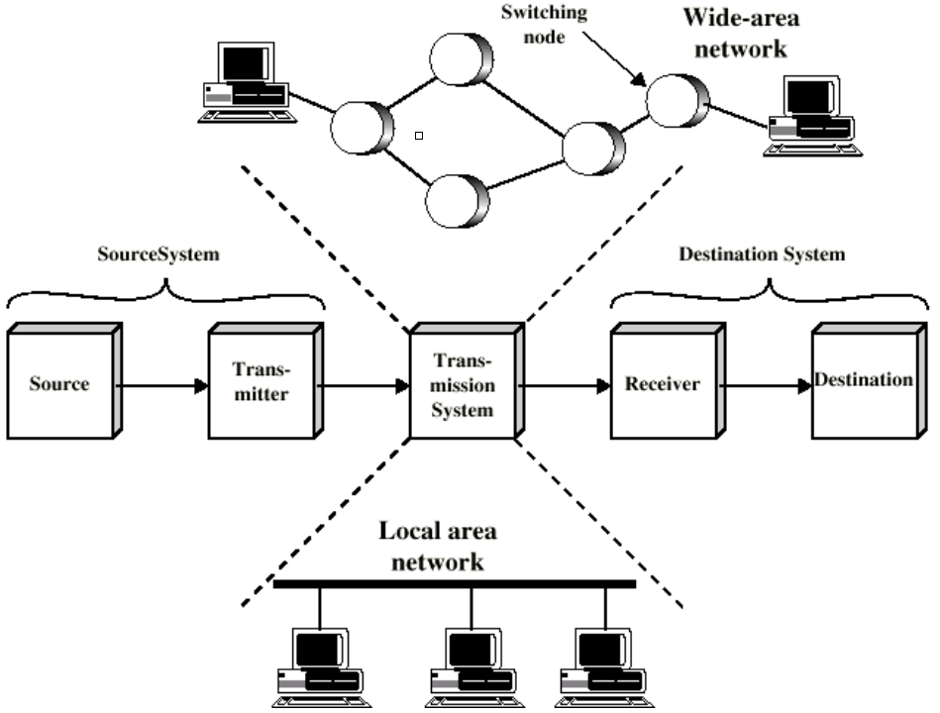
Conventional Communication Networks

Slide 16
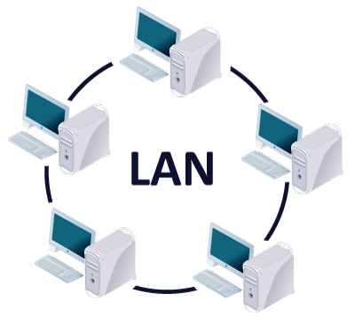
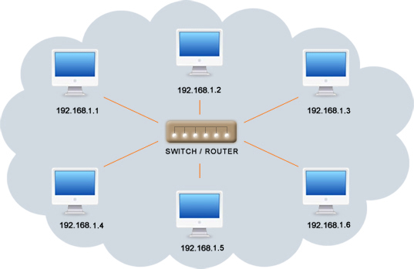
Local Area Networks (LANs)
Characteristics
Smaller scope
Building or small campus
Usually owned by same organization as attached devices
Data rates much higher
Categories
Switched LANs
Ethernet
Wireless LANs
ATM LANs
(Asynchronous Transfer Mode)
Token- Ring
Notes:
A LAN is a communications network that interconnects a variety of devices and provides a means for information exchange among those devices. The scope of the LAN is small, typically a single building or a cluster of buildings. It is usually the case that the LAN is owned by the same organization that owns the attached devices. The internal data rates of LANs are typically much greater than those of WANs.
LANs come in a number of different configurations. The most common are switched LANs and wireless LANs. The most common switched LAN is a switched Ethernet LAN, others are ATM & Fibre Channel LANs. Wireless networks provide advantages in the areas of mobility and ease of installation and configuration.
ATM: small cell in size of 53 bytes, 48 bytes for the data and 5 bytes for header

Slide 17
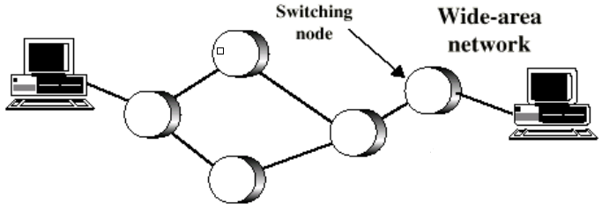
Wide Area Networks (WANs)
Characteristics
Span a large geographical area
Cross public rights of way
Technologies used include:
Circuit switching
Packet switching
Frame relay
Asynchronous Transfer Mode (ATM)
Notes:
Wide area networks generally cover a large geographical area, require the crossing of public right-of-ways, and rely at least in part on circuits provided by a common carrier. Typically, a WAN consists of a number of interconnected switching nodes. Traditionally, WANs have been implemented using one of two technologies: circuit switching and packet switching. More recently, frame relay and ATM networks have assumed major roles.
Packet switching: A large packet is divided into smaller packets, sent to the destination.
At the destination, they are collected and then, combined into one packet

Slide 18
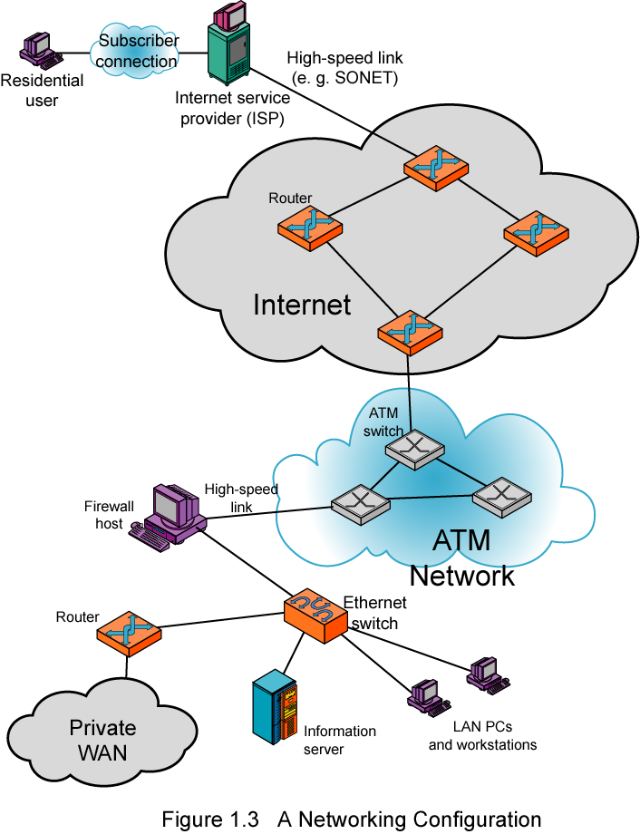
Internet Network
TCP/IP Architecture
Application
Transport
Internet
Data Link
Physical
Notes:
Stallings DCC8e Figure 1.6 illustrates some of the typical communications and network elements in use today. In the upper-left-hand portion of the figure, we see an individual residential user connected to an Internet service provider (ISP) through some sort of subscriber connection. The Internet consists of a number of interconnected routers that span the globe. The routers forward packets of data from source to destination through the Internet. The lower portion shows a LAN implemented using a single Ethernet switch. This is a common configuration at a small business or other small organization.

Slide 19
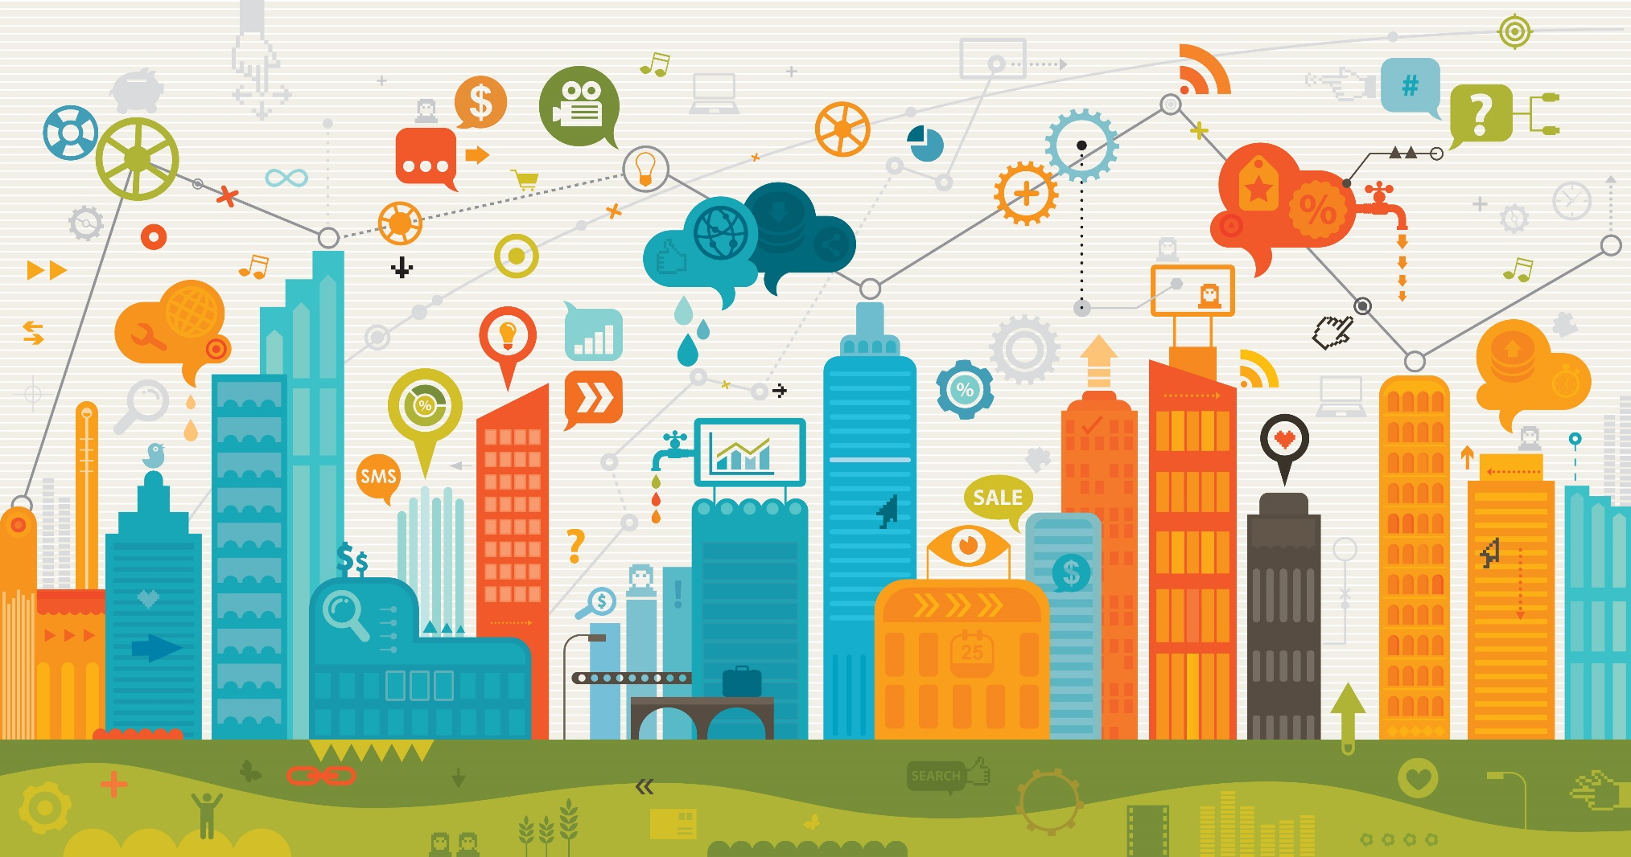
Internet of Things (IoTs)

Slide 20
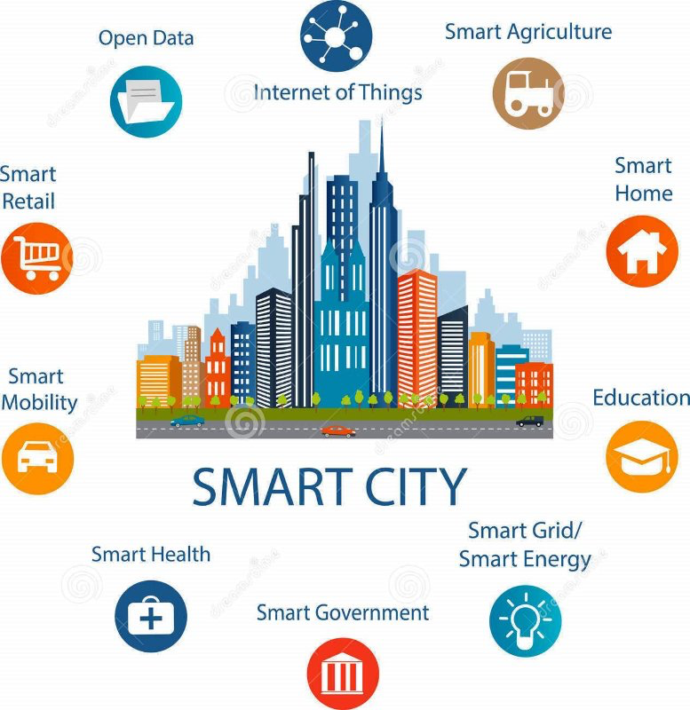
Internet of Things (IoT)
‹#›
Notes:
‹#›

Slide 21
Industry 4.0
Notes:
‹#›

Slide 22
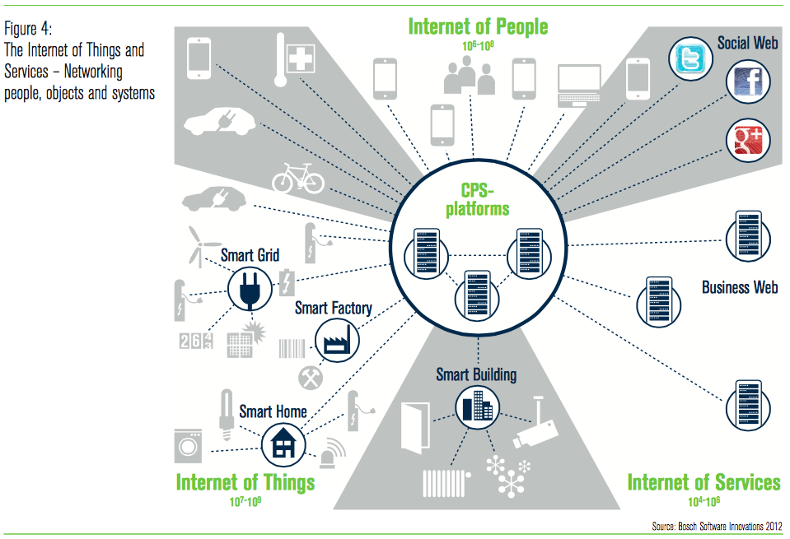
IoTs and Services
‹#›
Notes:
‹#›

Slide 23
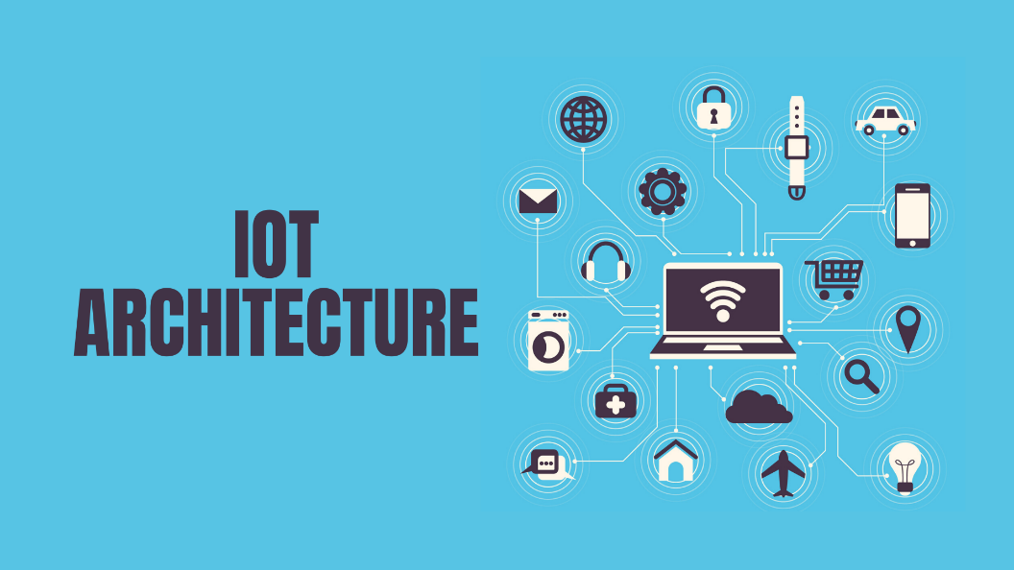
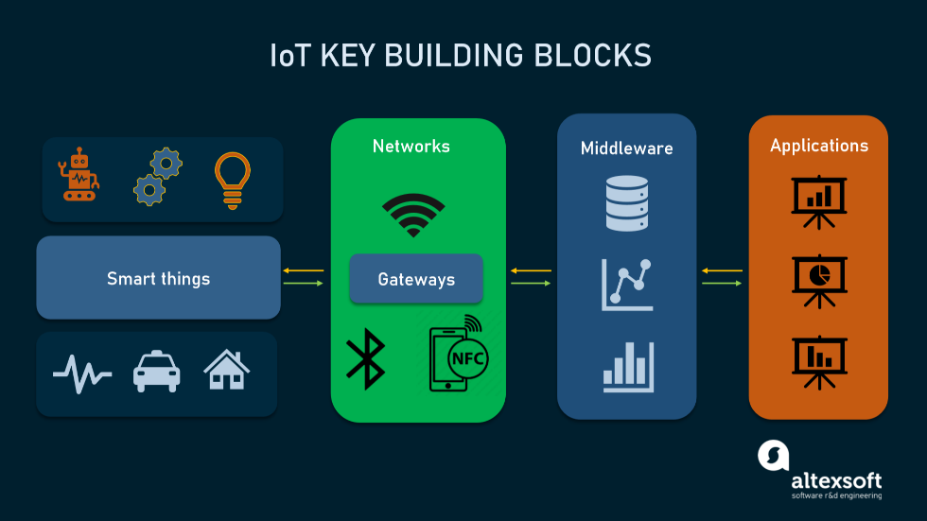
Industrial 4.0 Application Architecture
https://www.altexsoft.com/

Slide 24
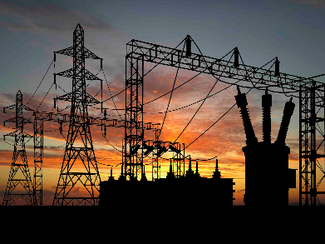
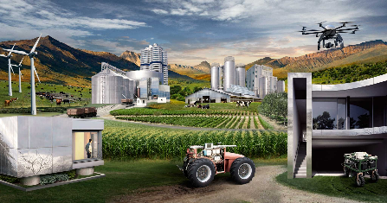
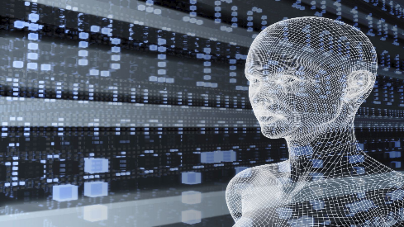
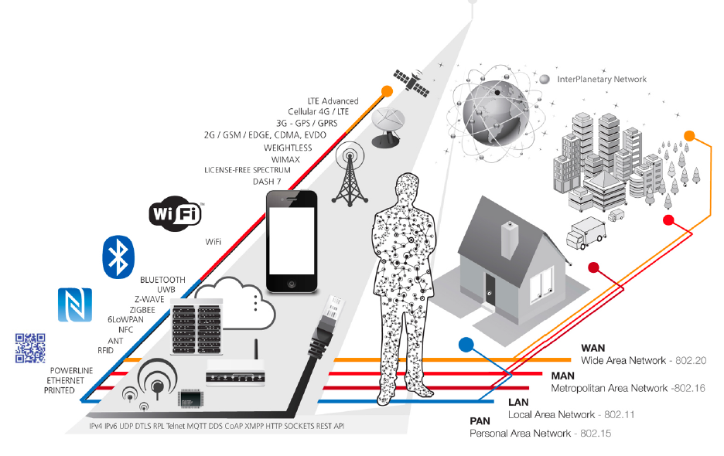
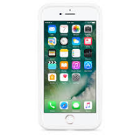
Industrial 4.0 Application (Timothy Chou)
Do
Learn
Collect
Connect
Things
Notes:
‹#›

Slide 25
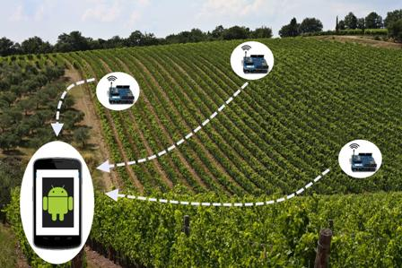
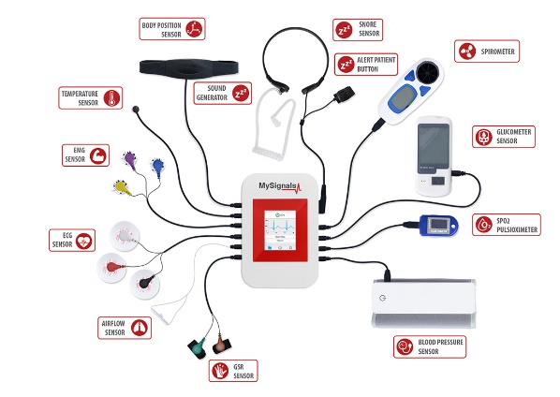
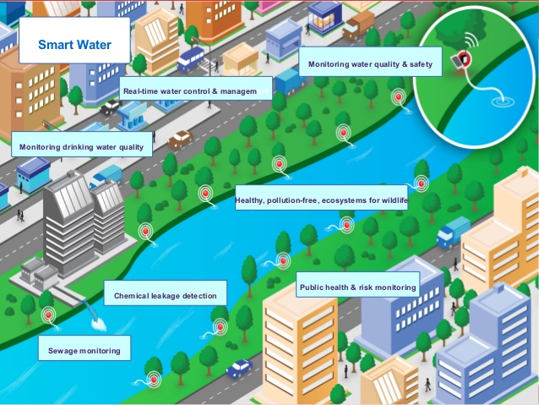
Things Layer
Sensors are selected according to the applications:
Easy configuration
Low cost - Long lifetime
Camera is used as a sensor
Actuators [MQTT Protocol]:
Remote control
Low latency
eHealth
Water Quality
Smart Agriculture

Slide 26
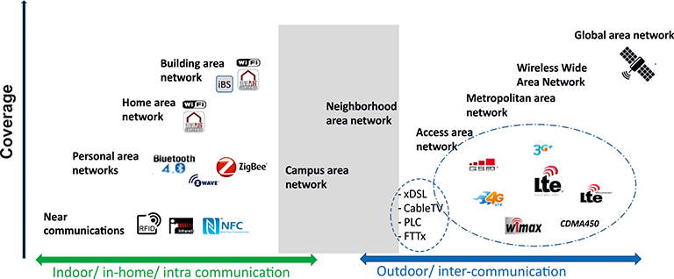
Connect Layer
More than 60 protocols are proposed every year
Mobility network

Slide 27
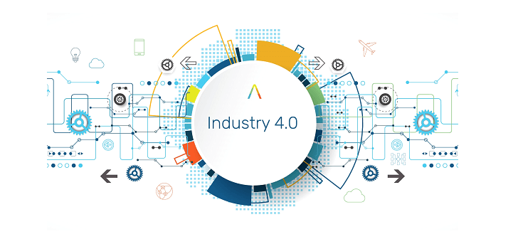
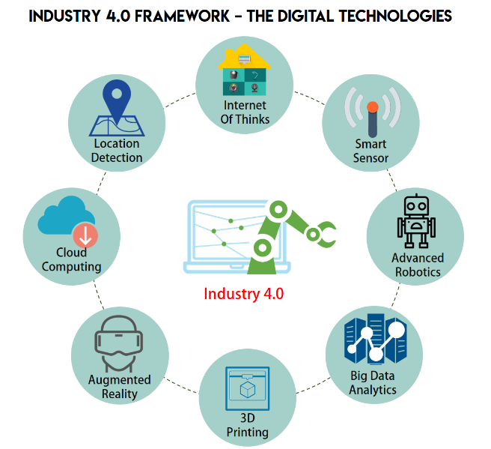
Potential I4 Applications

Slide 28
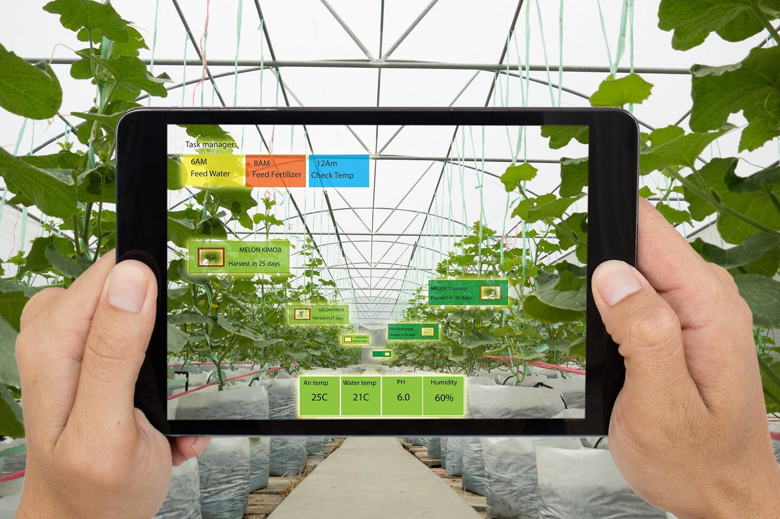
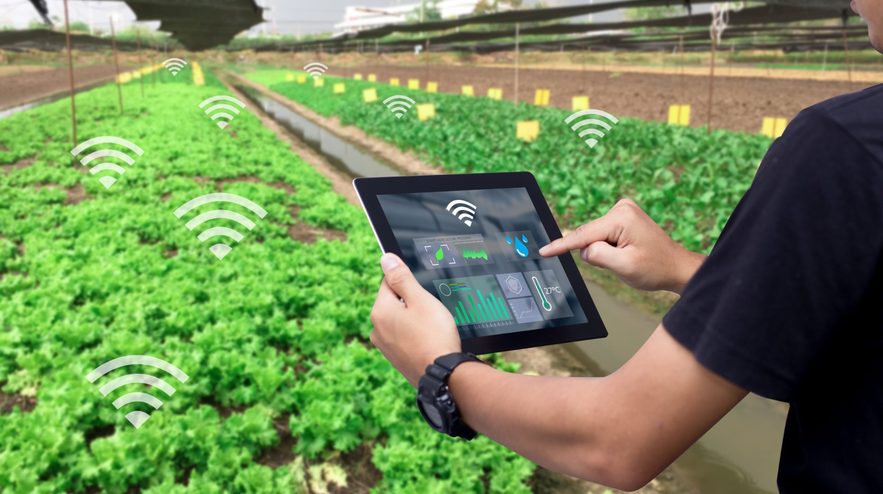
Smart Agriculture
Temperature and Humidity
pH, EC
Light intensity
Pump controllers
Data analytics, AI and Blockchain

Slide 29
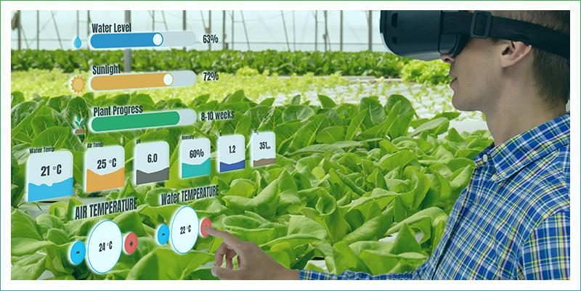
Monitoring system based AR/VR

Slide 30
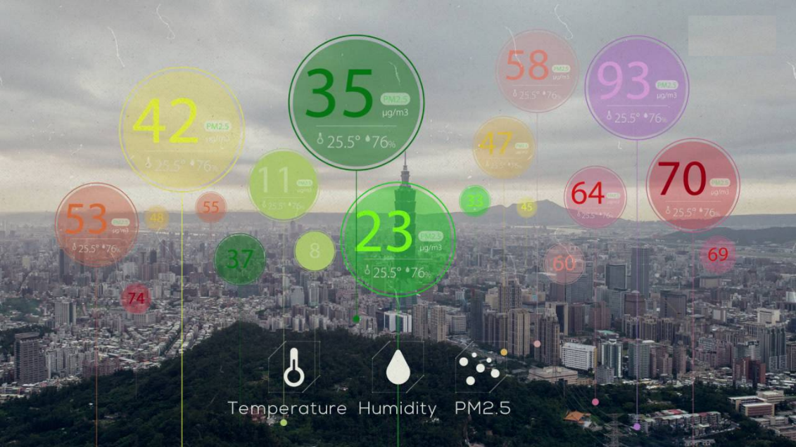

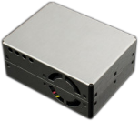
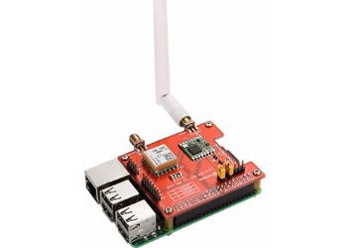

Air Quality Monitoring
Air quality monitoring program assists us in improving and developing air pollution control programs to reduce the effect of air pollution.
PM2.5, PM10, CO2, CO

Slide 31
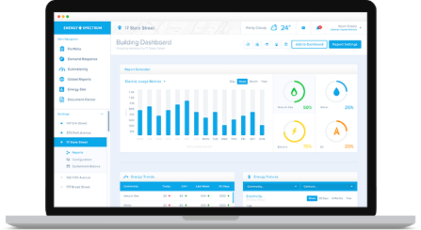
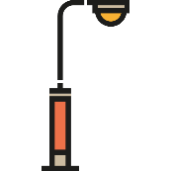
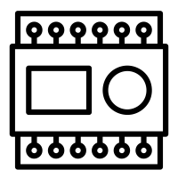
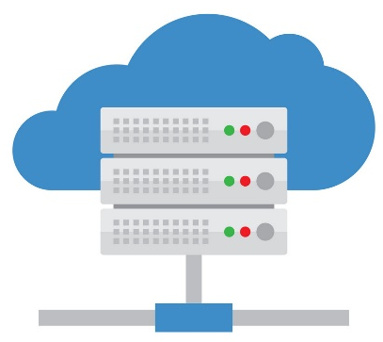
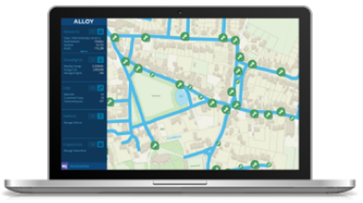
Smart Street Light
Management System
Street Light 1
…
Generic IoT Platform
Internet Connection
(Wifi/3G/4G/5G)
Street Light 2
…
PLC
Monitoring System

Slide 32
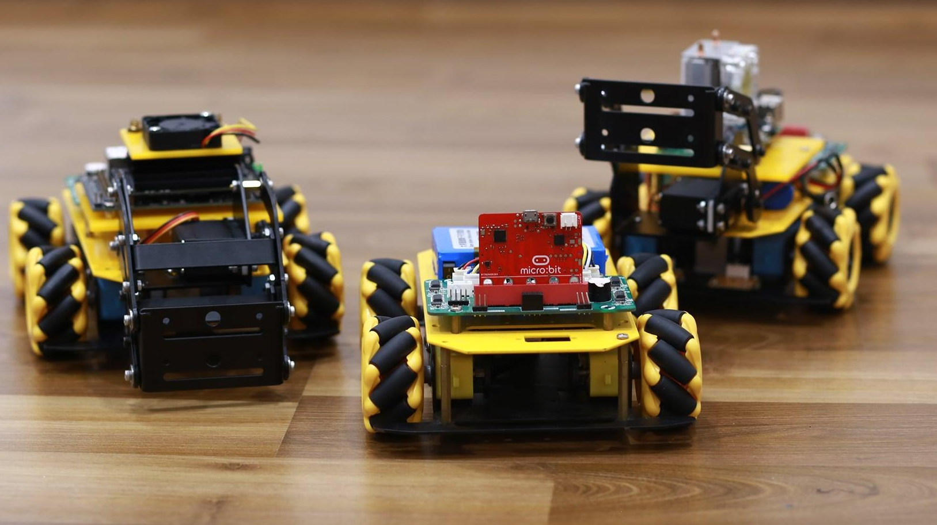
Autonomous Robots
Smart warehouse applications

Slide 33
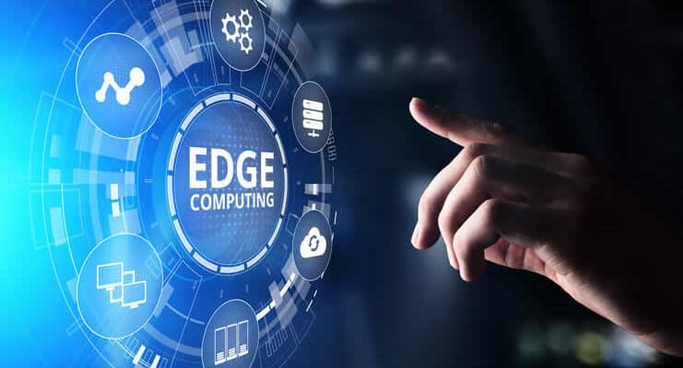
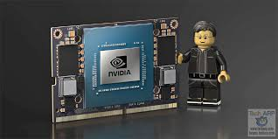
Edge Computing in Internet of Things Applications

Slide 34
Edge Computing
Notes:
Edge computing is a distributed computing paradigm that makes necessary computation and data storage closer to the devices where it is collected. Compared to relying on a central location such as a server, Edge Computing enables real-time data not to suffer from bandwidth and latency issues that affect device performance.
To put it more clearly, instead of running processes in the cloud, Edge Computing runs operations like a computer, IoT system, or Edge Server at local locations. Long-distance communication within a client and server is now reduced by taking computation to a network edge. Edge computing capacity for computation and processing is needed to run Edge AI applications and algorithms directly on field devices, allowing ML and DL. The amount of data collected by IoT devices in the field is growing exponentially: ML and DL allow Edge AI applications to handle those data in real-time better. It creates Edge nodes where data can be stored, analyzed, sorted, and then forwarded to the cloud for further analysis, processing, and integration with IT apps.

Slide 35
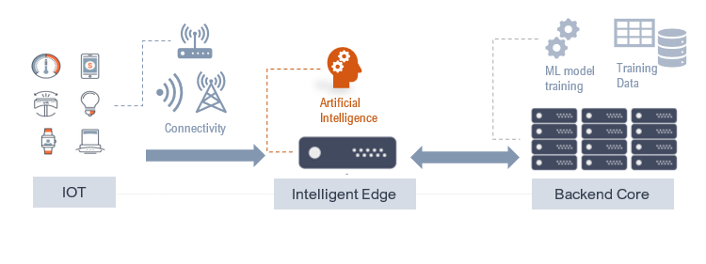
Combine it with AI = Edge AI
Edge AI overcomes the latency of data and complex computations:
Increase in levels of Automation
Digital Twins for Advanced Analytics
Real-Time Decision Making
Edge Inference and Training
Notes:
Data centers are also clustered servers, where the cost of real estate and electricity is lower. Data can’t fly faster than the speed of light except on the zippiest fiber-optic networks. This physical gap creates latency between data and data centers.
Edge AI takes this distance forward.
Edge AI can be run at multiple network nodes to practically close the data-processing gap to reduce bottlenecks and speed up applications.
Billions of IoT and multiple devices run on lightweight, embedded processors at the periphery of the networks, suitable for simple video applications.

Slide 36
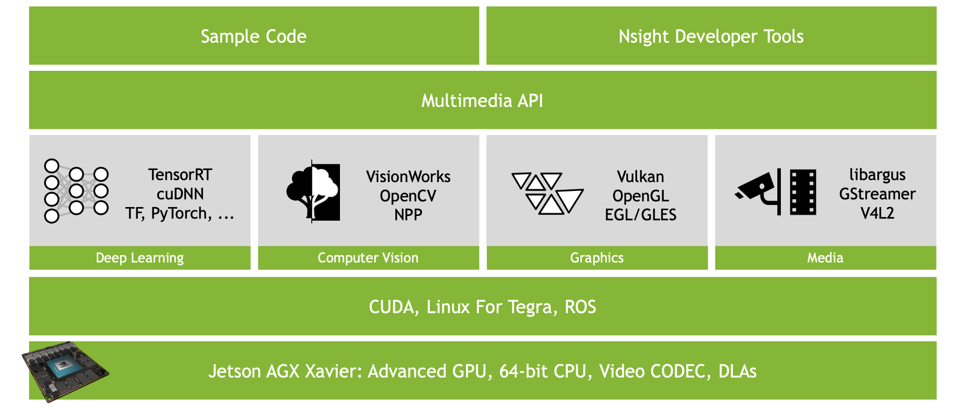
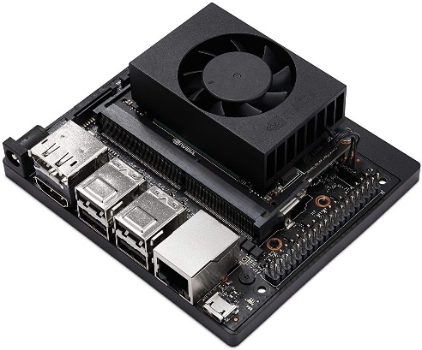
Edge AI on Embedded Platform
384 NVIDIA CUDA cores and 48 Tensor Cores

Slide 37
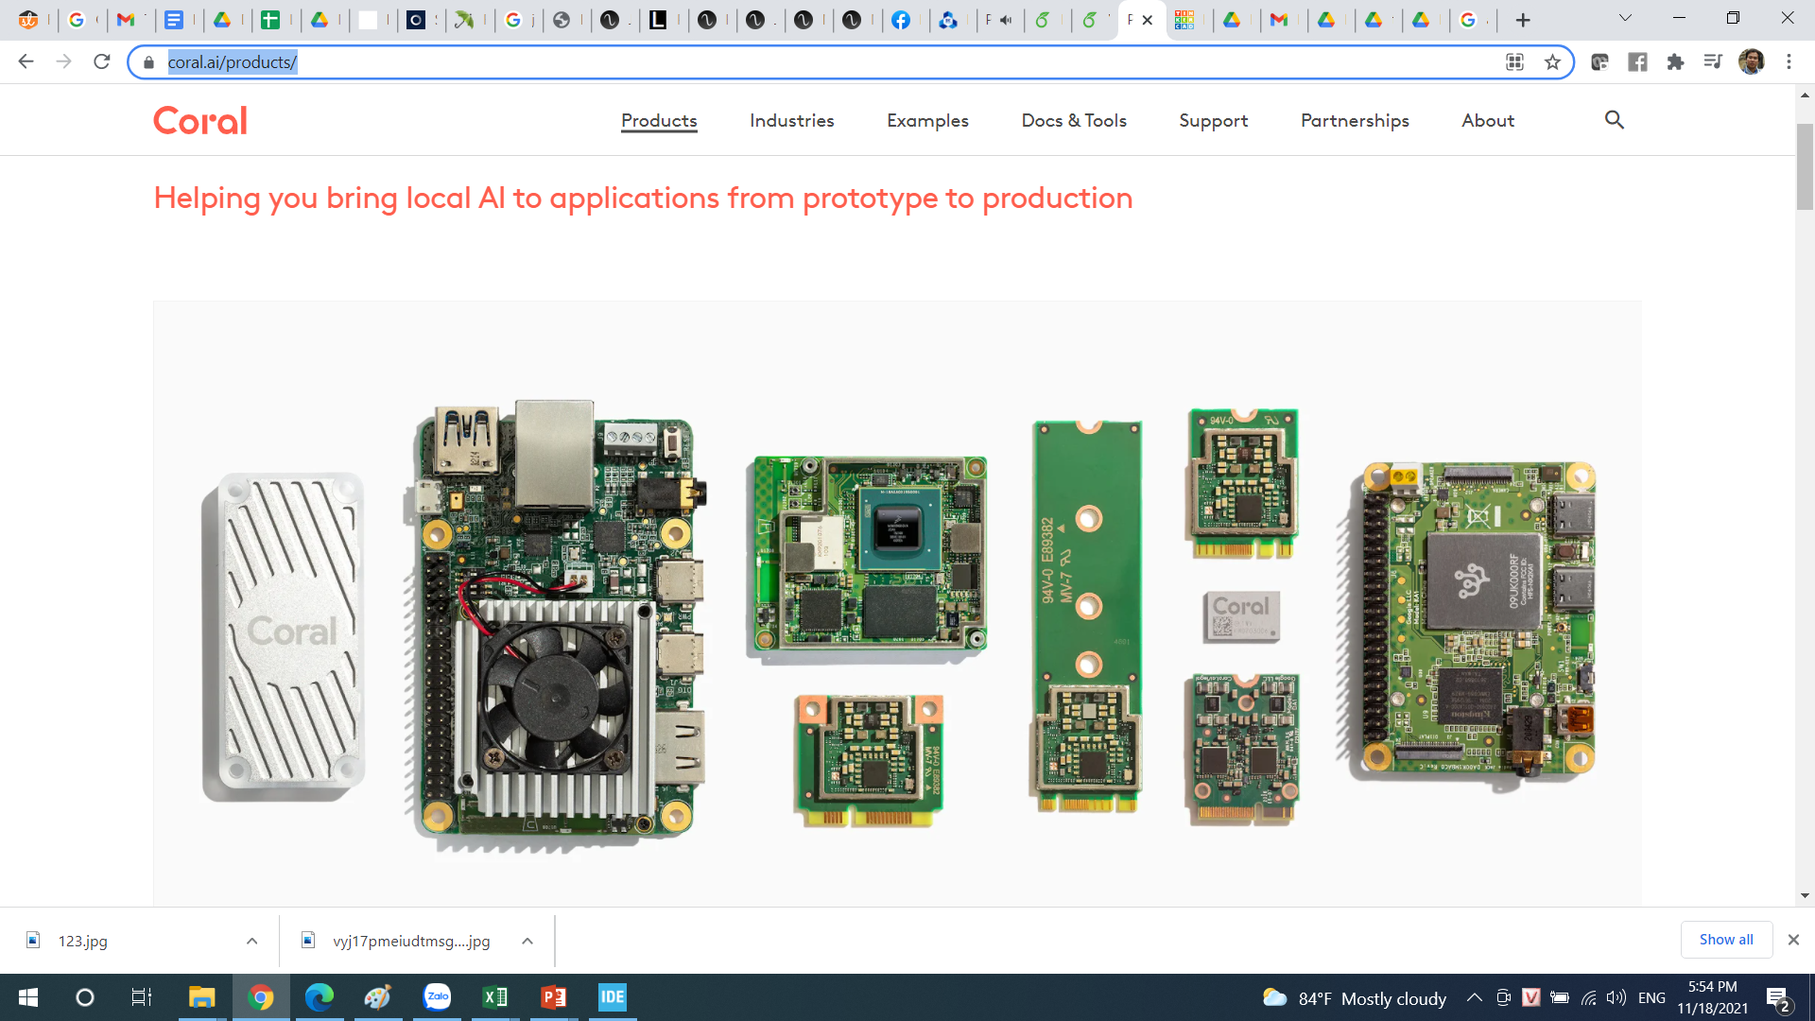
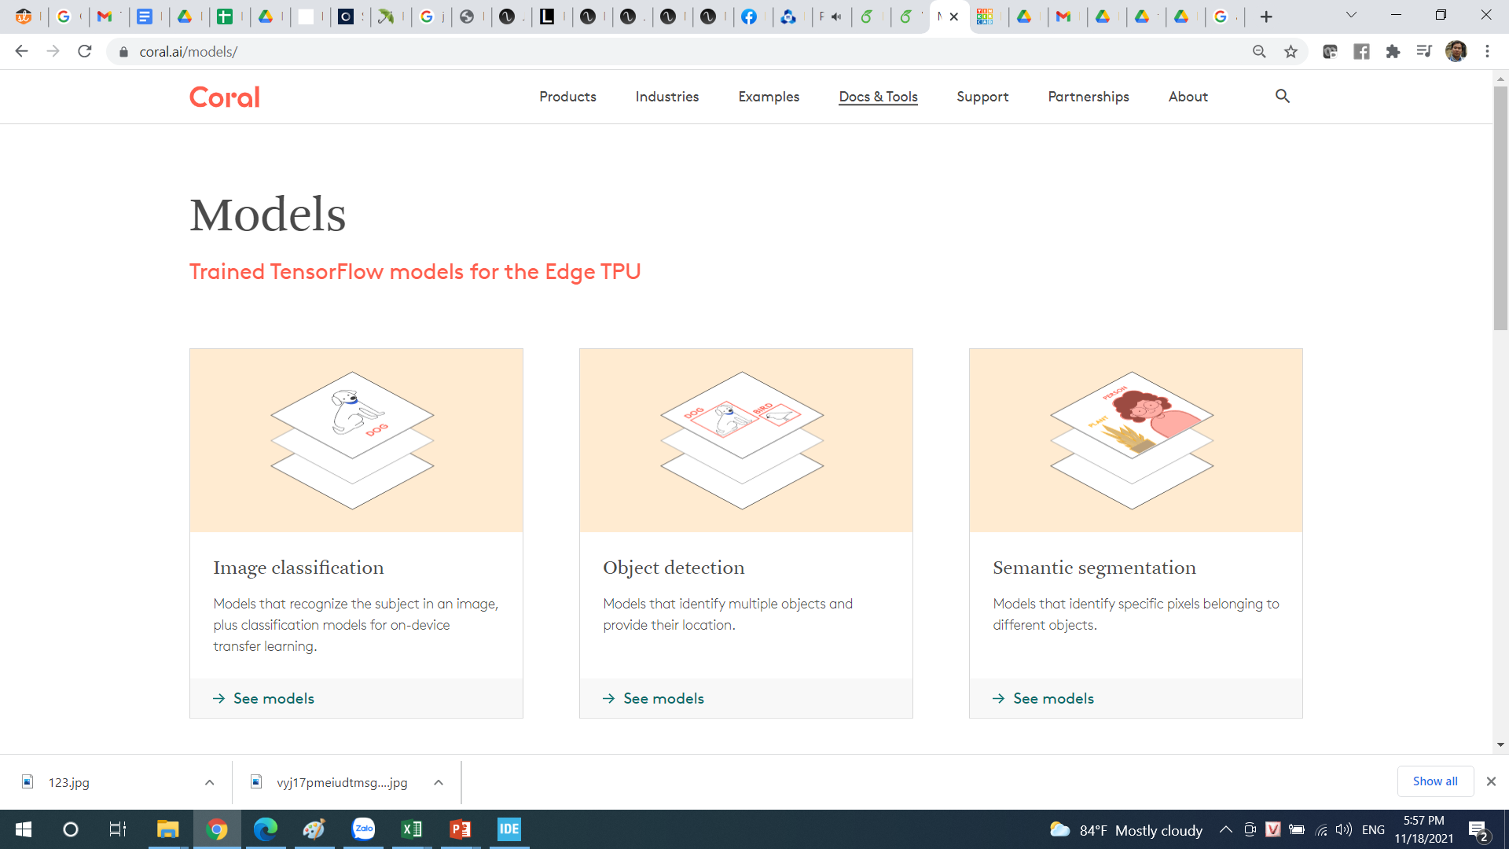

PyCoral [https://coral.ai/products/]

Slide 38

Train an AI Model
Application Dev

Slide 39
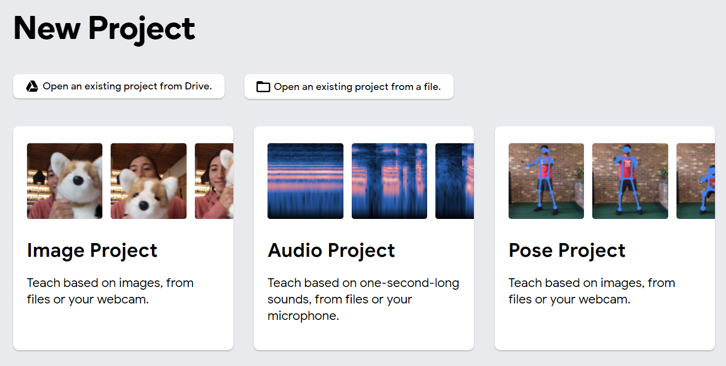
Demo with Google TM
https://teachablemachine.withgoogle.com/train

Slide 40


WSL on Windows (Windows Subsystem Linux)

Slide 41

WSL on Windows
Can be found on Microsoft Store

Slide 42

C Program on WSL
sudo nano first_demo.c
Implement your program
Ctrl X 🡪 Y(es) 🡪 Enter to finish

Slide 44
Run C program on WSL
Compile from C source code to Object file
gcc –c first_demo.c –o first_demo.o
Compile from object file to executable filed
gcc first_demo.o –o first_program
Run the program
./first_program

Slide 45

Install python on WSL
sudo apt update
sudo apt install python
sudo apt install python3
sudo apt install python-pip
sudo apt install python3-pip

Slide 46

Python Program on WSL
sudo nano first_demo.py
Implement your program
Ctrl X 🡪 Y(es) 🡪 Enter to finish

Slide 47

Run Python Source Code
python3 first_demo.py
Run a Python seems simple than a C program???

